Slide 1
UNIT 3
Small-Scale Fading
WEEK-2
Small scale multipath measurements - Direct Pulse measurement, Sliding correlator measurement, Swept frequency measurement, Parameters of mobile multipath channels - Time dispersion and Coherent bandwidth, Parameters of mobile multipath channels - Doppler spread and Coherent time

Slide 2
Small-Scale Multipath Measurements
Multipath structure is very important for small scale fading.
Several Methods
Direct RF Pulse System
Spread Spectrum Sliding Correlator Channel Sounding
Frequency Domain Channel Sounding
These techniques are also called channel sounding techniques

Slide 3
Direct RF Pulse System
This method help us to determine the power delay profile directly
Objective is to find impulse response
A narrow pulse is used for channel sounding.
At the receiver the signal is amplified and detected using an envelop detector.
It is then stored on a high speed digital oscilloscope.
If the receiver is set on averaging mode, the local average power delay profile is obtained

Slide 4
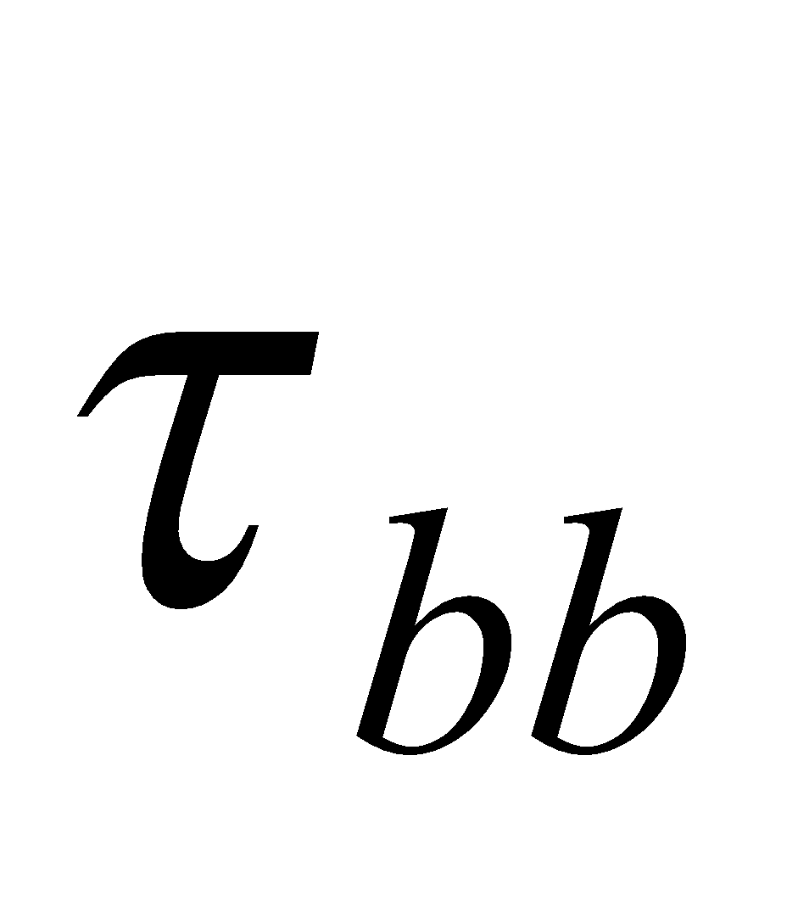
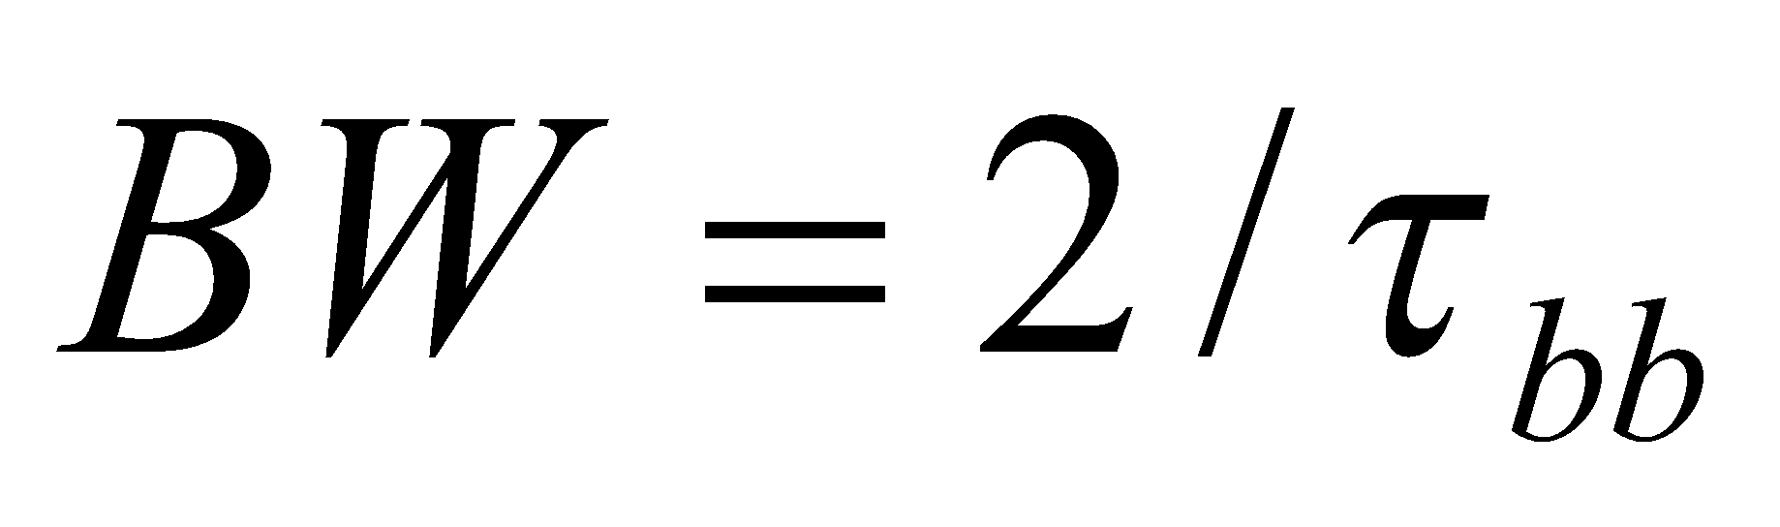
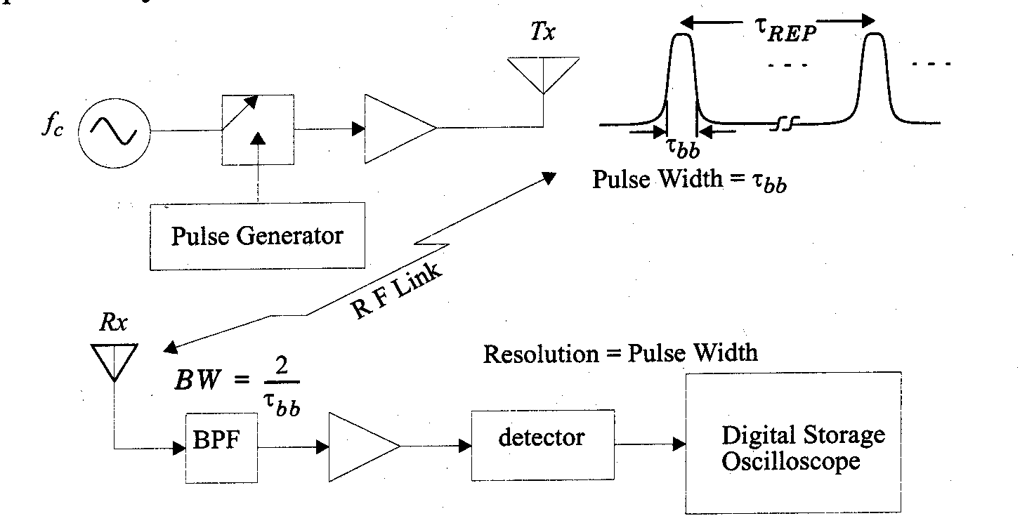
Direct RF Pulse System
Direct RF pulse system
This system transmits a repetitive pulse of width , and uses a receiver with a wideband filter with bandwidth
Envelope detector to detect the amplitude response.
Minimum resolvable delay
No phase information can be measured.

Slide 5
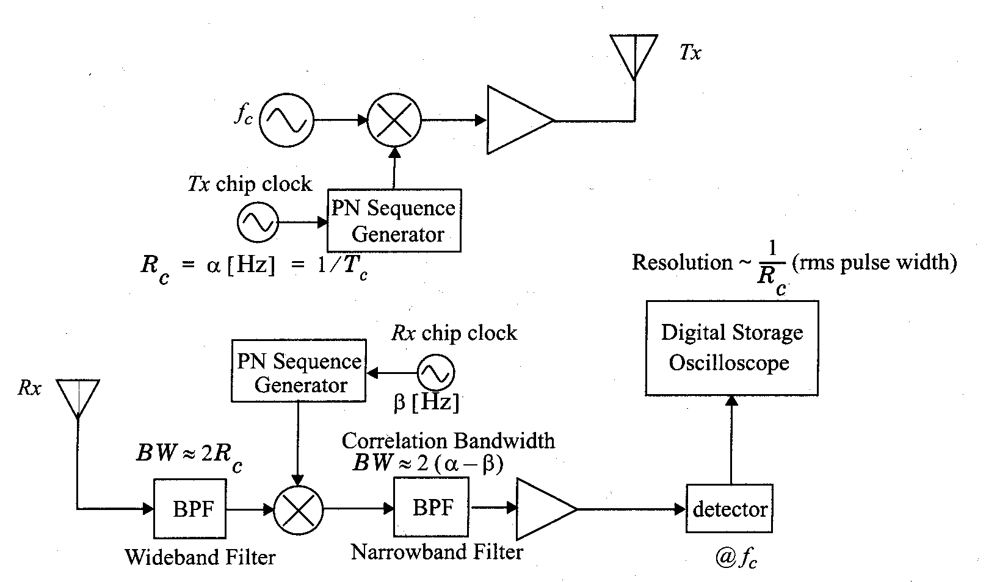
Direct RF Pulse System

Slide 6
Direct RF Pulse System
Problems
Subject to interference
Subject to noise due to wideband pass band filter required for multipath resolution
The phases of individual multi path components are not received due to the use of envelop detector

Slide 7
Spread Spectrum Sliding Correlator Channel Sounding
The probing signal is wide band but the receiver is narrow band
The carrier signal is spread over large bandwidth by mixing it with Pseudorandom Noise (PN) sequence having chip rate Tc.
At receiver signal is despread using same PN
The transmitter chip clock rate is a little faster then the receiver chip clock rate
The result is sliding correlator.
If the sequences are not maximally correlated then the mixer will further despread the signal

Slide 8
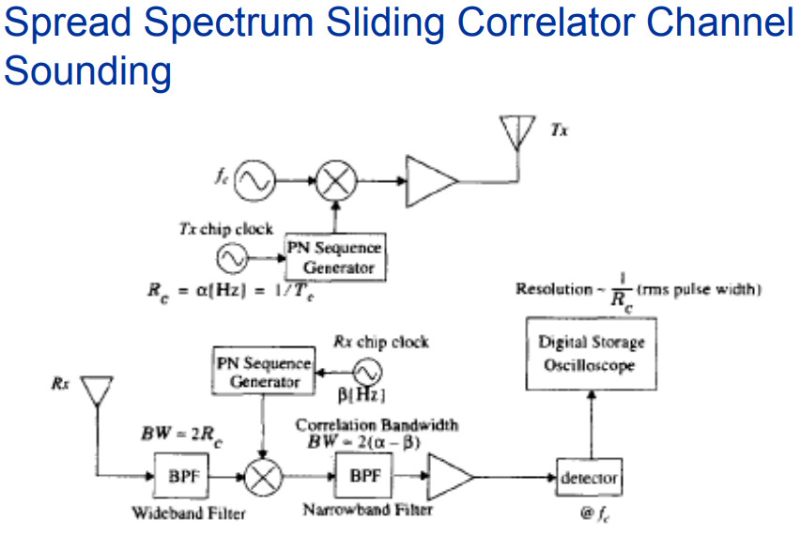

Slide 9

Spread Spectrum Sliding Correlator Channel Sounding
The chip rate Rc=1/Tc.
RF bandwidth = 2Rc
Processing gain:
Time resolution ΔT=2Tc = 2/Rc
Sliding factor (gamma) , γ = α/α-β
α = transmitter chip rate
β =receiver chip rate

Slide 10
Spread Spectrum Sliding Correlator Channel Sounding
Advantages:
Improves coverage range using same transmitter power.
Transmitter receiver synchronization is eliminated using sliding correlator.
Disadvantages:
Measurement are not made real time
The associated time required is more
Phase information is lost.

Slide 11
Frequency Domain Channel Sounding
Because of the dual relationship between time and frequency it is possible to measure channel impulse response in frequency domain
A vector network analyzer is used.
The S-parameter test set is used to monitor the frequency response of the channel.
The frequency sweeper scans a particular frequency band by stepping through the discrete frequencies.

Slide 12
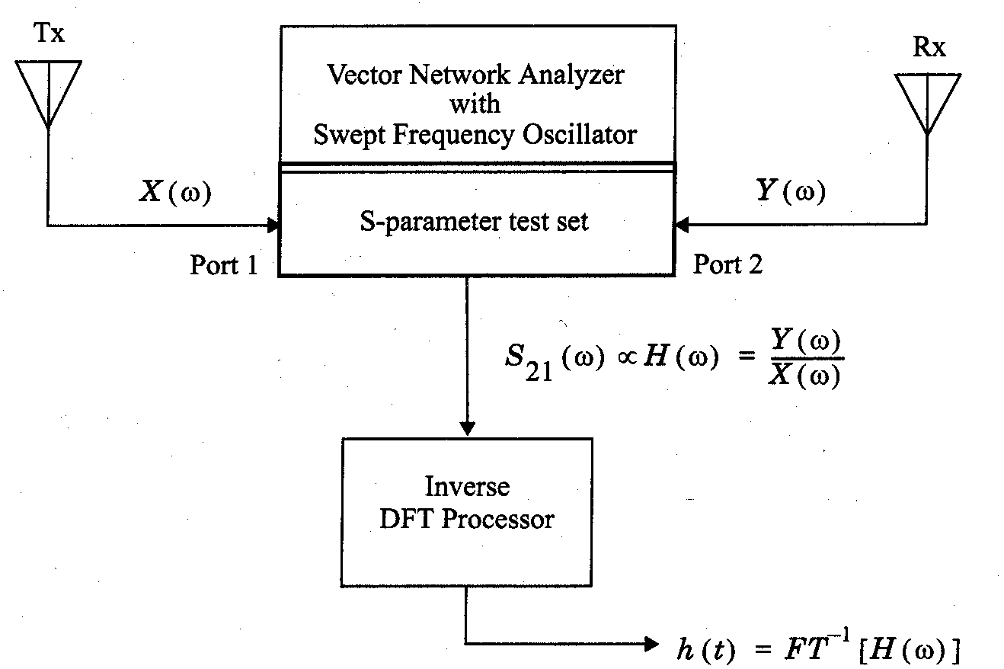
Frequency Domain Channel Sounding
Dual relationship between time domain and frequency domain.
It is possible to measure the channel impulse response in the frequency domain.
Measure the frequency domain response and then converted to the time domain using inverse discrete Fourier transform (IDFT).

Slide 13
Frequency Domain Channel Sounding
Disadvantages:
System requires careful calibration
System required hardwired synchronization between transmitter and receiver.
Practical only for indoor channel measurements
Non real time nature of measurements
For time varying channels the channel impulse response may change giving erroneous measurements

Slide 14
Parameters of Mobile Multipath Channels
Parameters of Mobile Multipath Channels
Time Dispersion Parameters
Grossly quantifies the multipath channel
Determined from Power Delay Profile
Parameters include
Mean Access Delay
RMS Delay Spread
Excess Delay Spread (X dB)
Coherence Bandwidth
Doppler Spread and Coherence Time

Slide 15
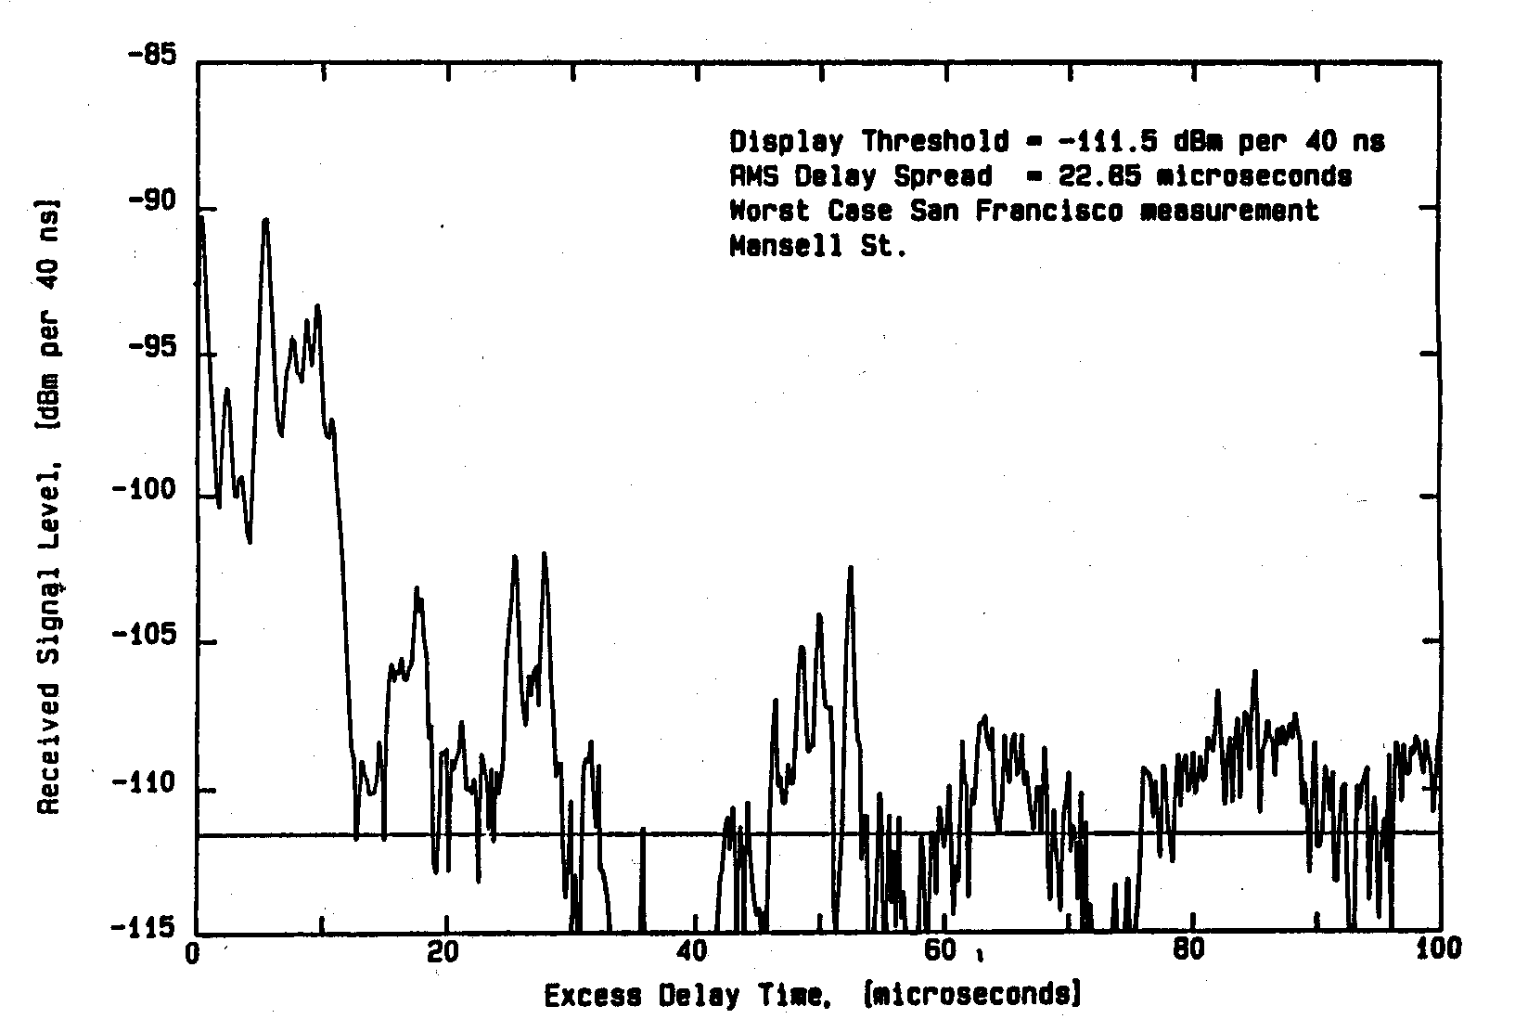
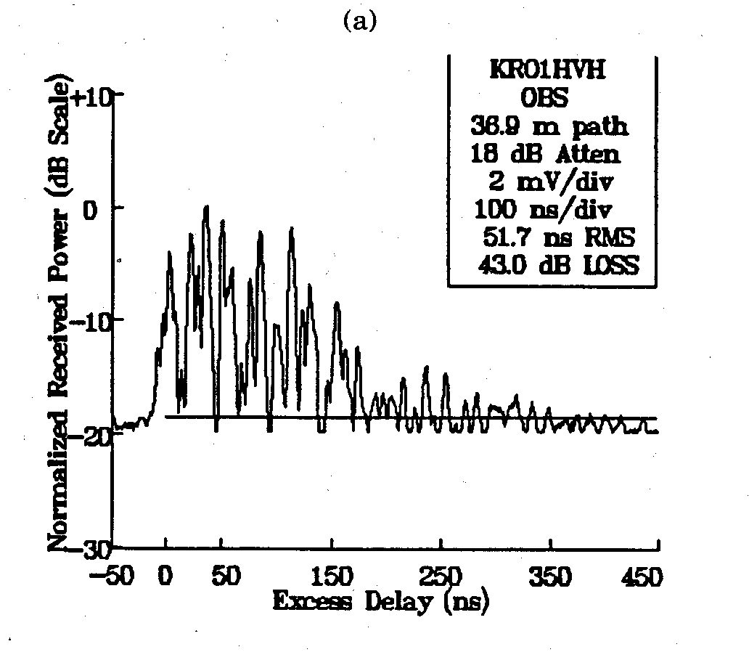
Parameters of Mobile Multipath Channels
Time dispersion parameters (time domain) (time dispersive nature of the channel)
Coherent bandwidth (frequency domain) (time dispersive nature of the channel)
Doppler spread and coherent time (time varying nature of the channel)
Power delay profiles for different types of channels are different
Indoor
Outdoor

Slide 16
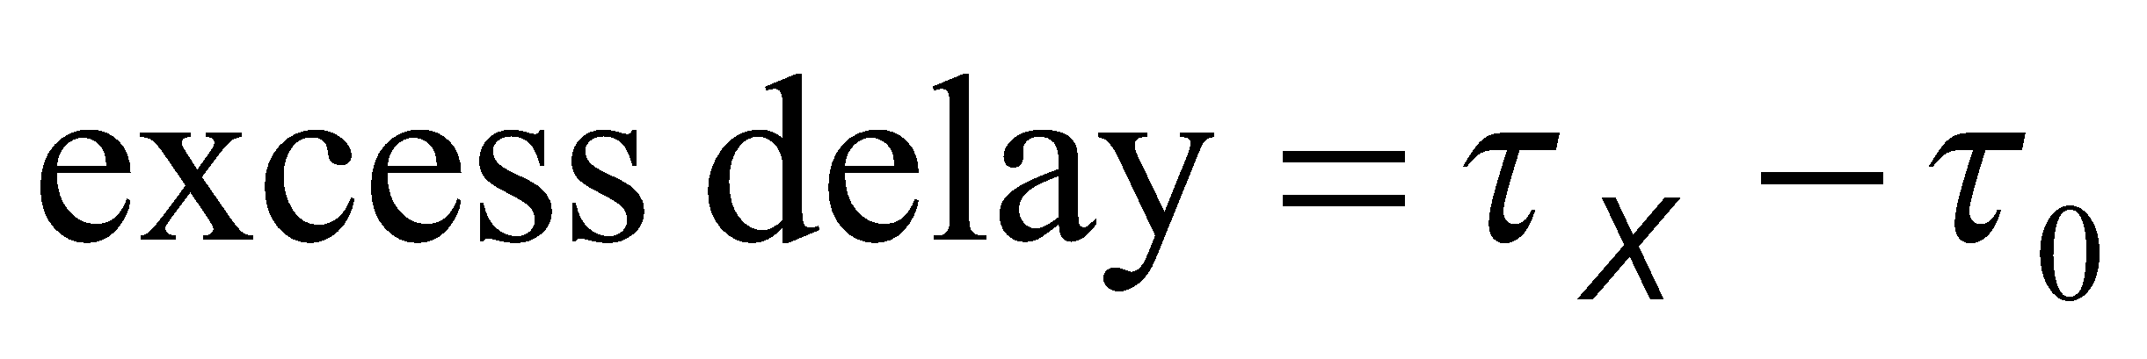
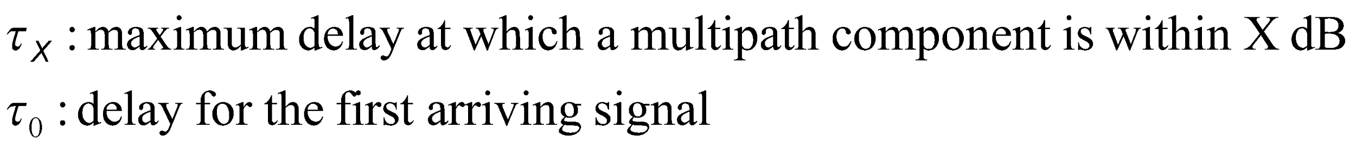
Time Dispersion Parameters
Depends only on the relative amplitude of the multipath components.
Typical RMS delay spreads
Outdoor: on the order of microseconds
Indoor: on the order of nanoseconds
Maximum excess delay (X dB) is defined to be the time delay during which multipath energy falls to X dB below the maximum.

Slide 17
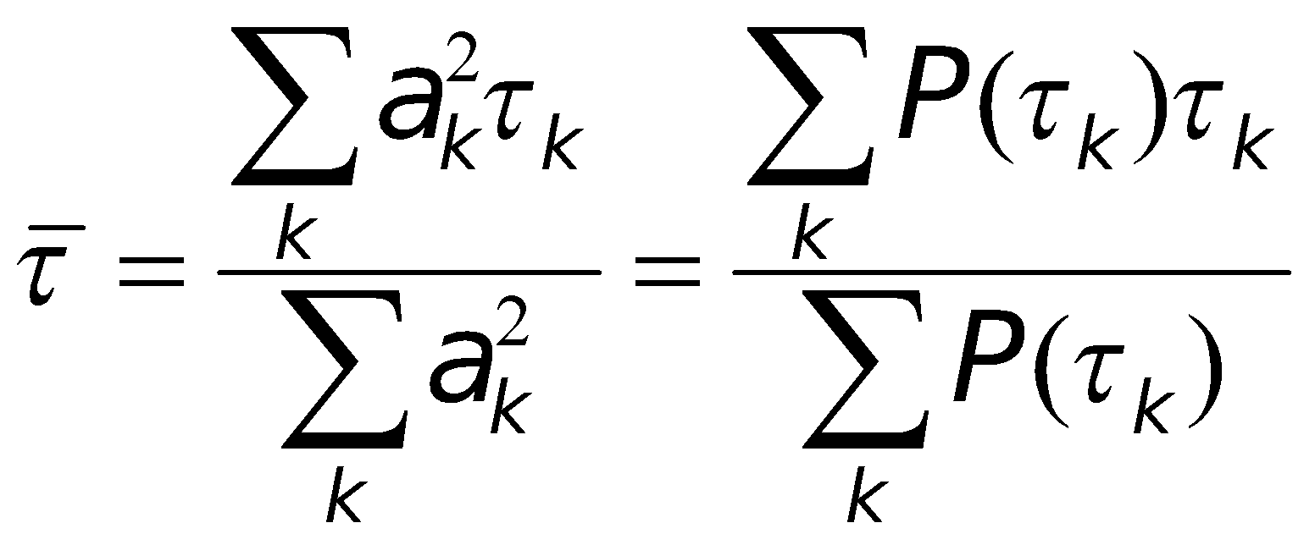
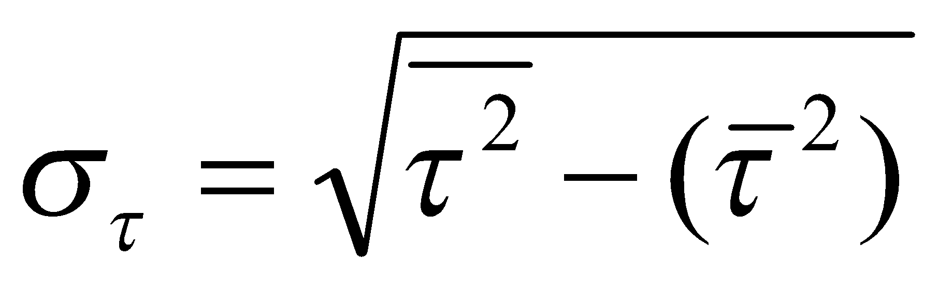
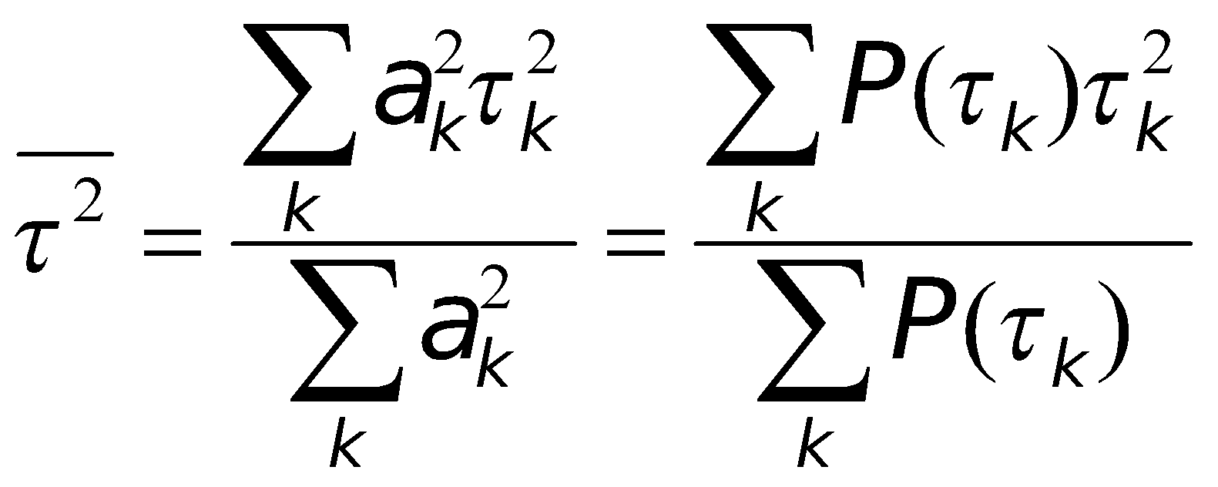
Time Dispersion Parameters
Time dispersion parameters
mean excess delay
RMS delay spread
excess delay spread
Mean excess delay
RMS delay spread
where

Slide 18
Delay Spread, Coherence Bandwidth
Describes the time dispersive nature of a channel in a local area
A received signal suffers spreading in time compared to the transmitted signal
Delay spread can range from a few hundred nanoseconds for indoor scenario up to some microseconds in urban areas
The coherence bandwidth Bc translates time dispersion into the language of the frequency domain.
It specifies the frequency range over which a channel affects the signal spectrum nearly in the same way, causing an approximately constant attenuation and linear change in phase
The rms delay spread and coherence bandwidth are inversely proportional to each other.

Slide 19
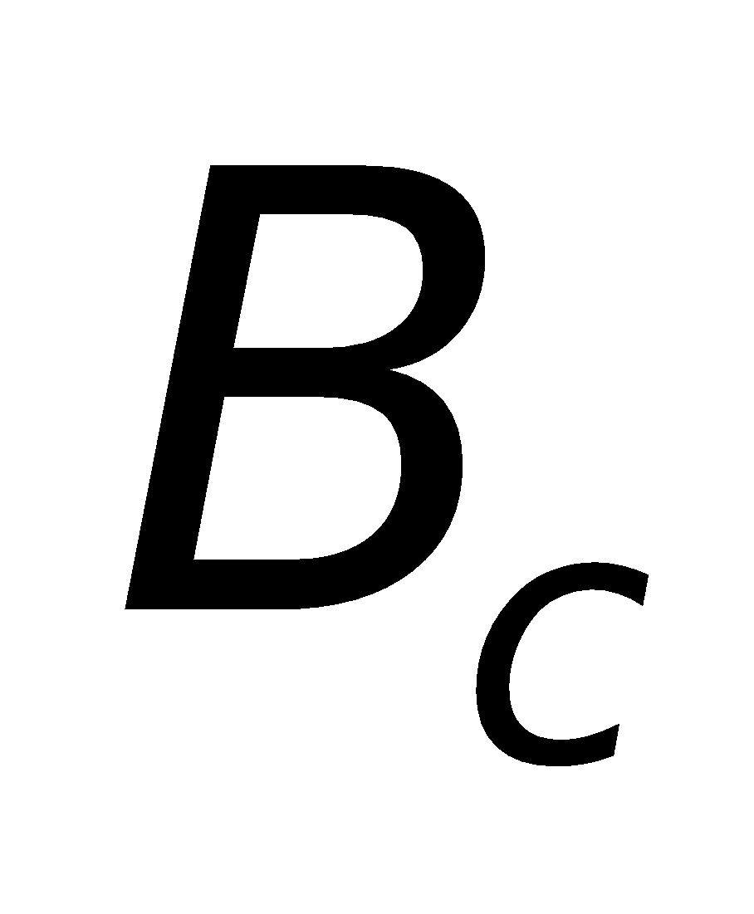
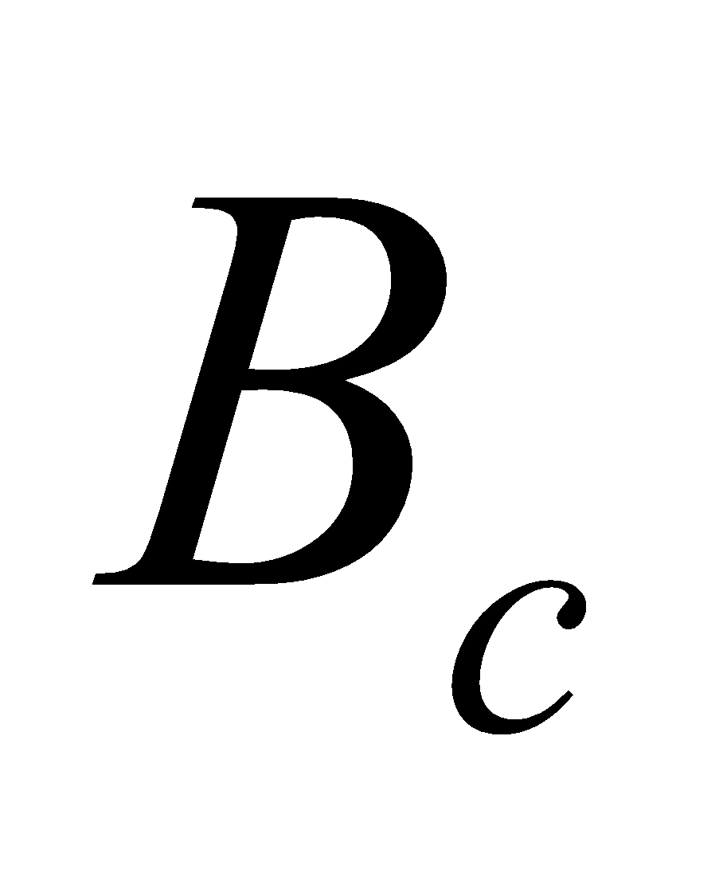
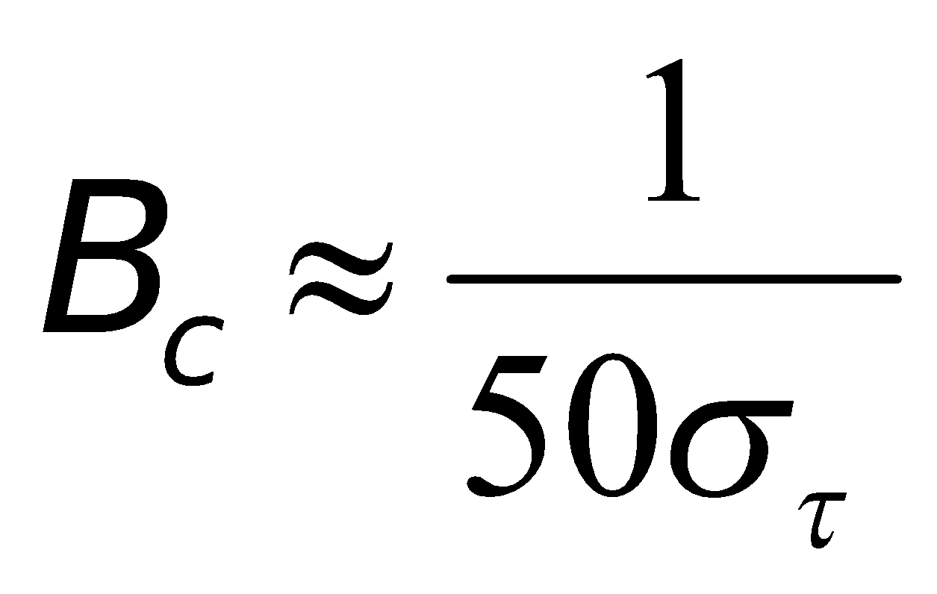
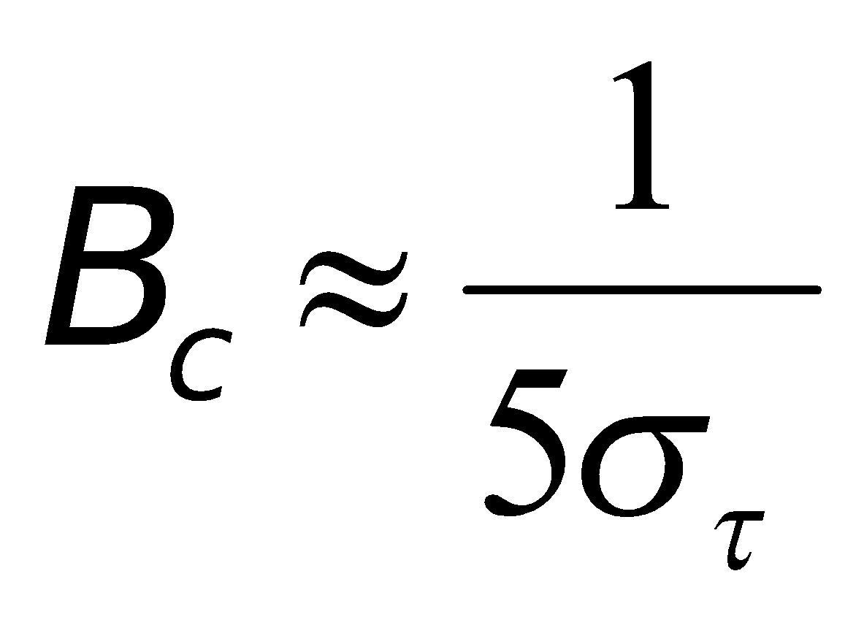
Coherent Bandwidth
Coherent bandwidth, , is a statistic measure of the range of frequencies over which the channel can be considered to be “flat”.
is inversely proportional to rms delay spread.
Two sinusoids with frequency separation greater than are affected quite differently by the channel.
If the coherent bandwidth is defined as the bandwidth over which the frequency correlation function is above 0.9, then the coherent bandwidth is approximately
If the frequency correlation function is above 0.5

Slide 20
Doppler Spread and Coherence time
Delay spread and Coherence bandwidth describe the time dispersive nature of the channel in a local area. They don’t offer information about the time varying nature of the channel caused by relative motion of transmitter and receiver.
Doppler Spread and Coherence time are parameters which describe the time varying nature of the channel in a small-scale region.
Time varying nature of channel caused either by relative motion between BS and mobile or by motions of objects in channel are categorized by B_{D} and T_{c}

Slide 21
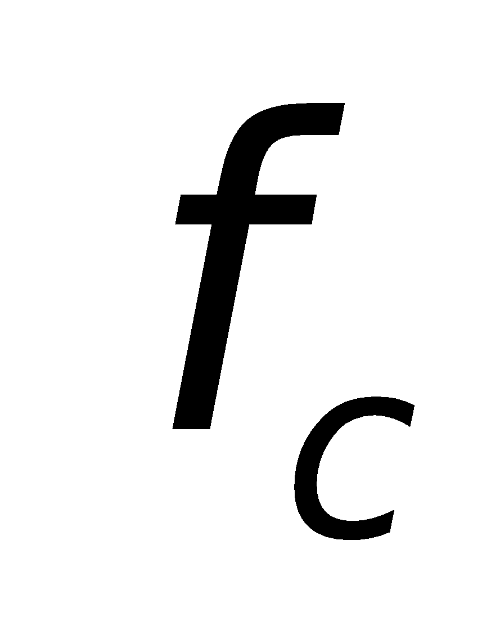
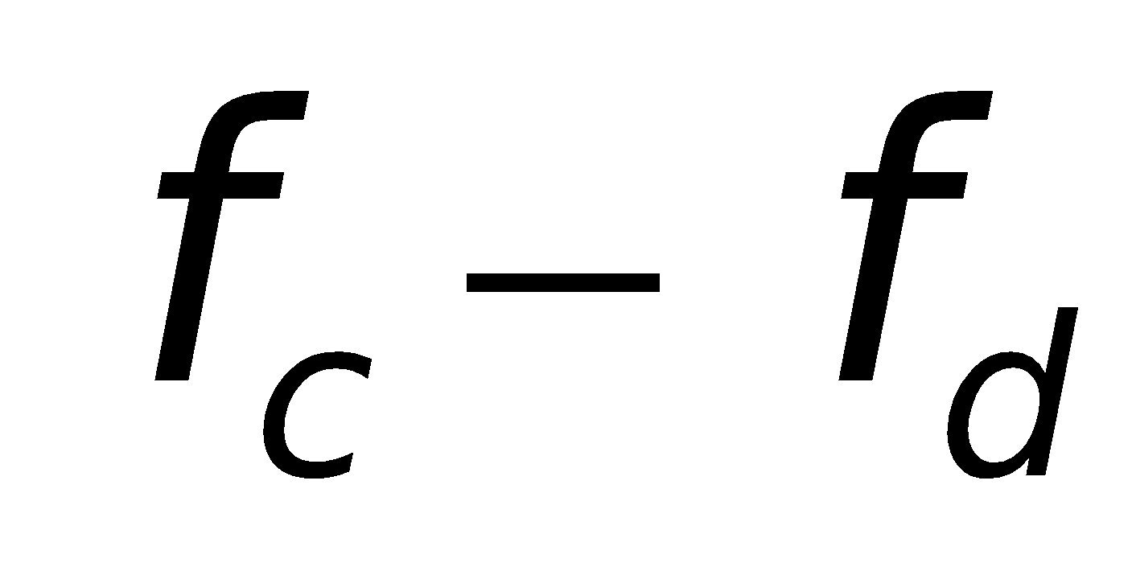
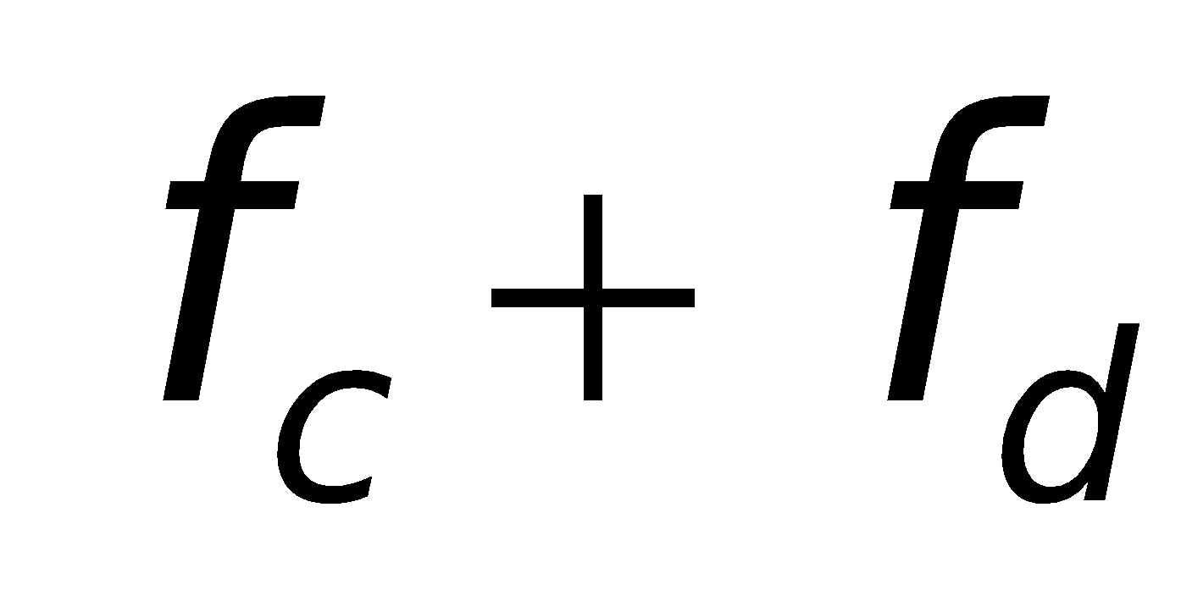
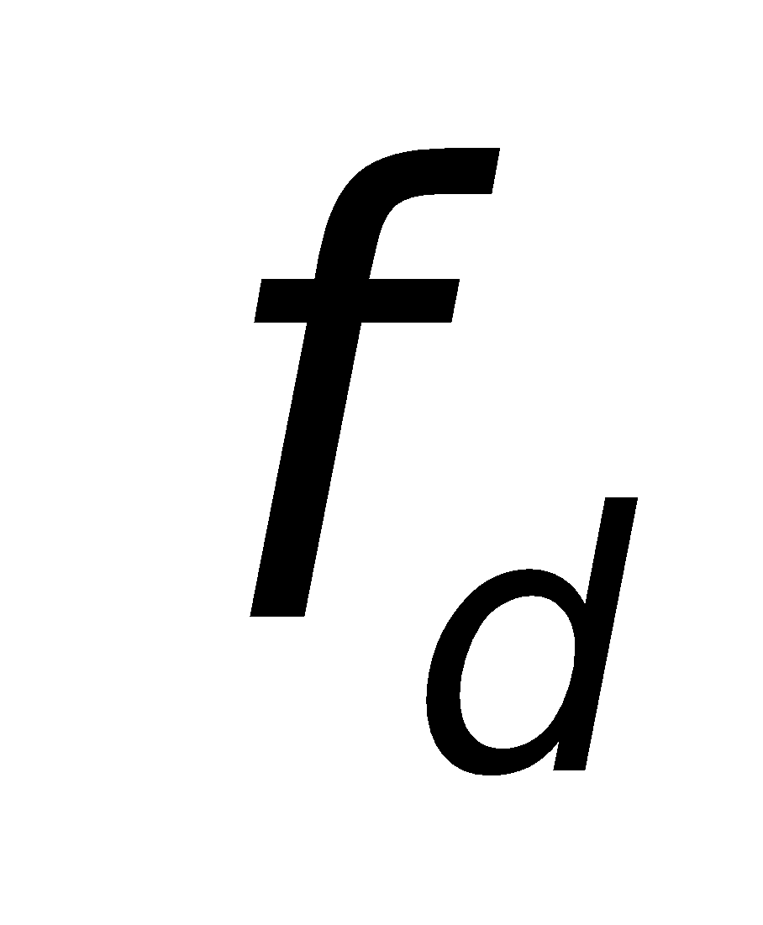
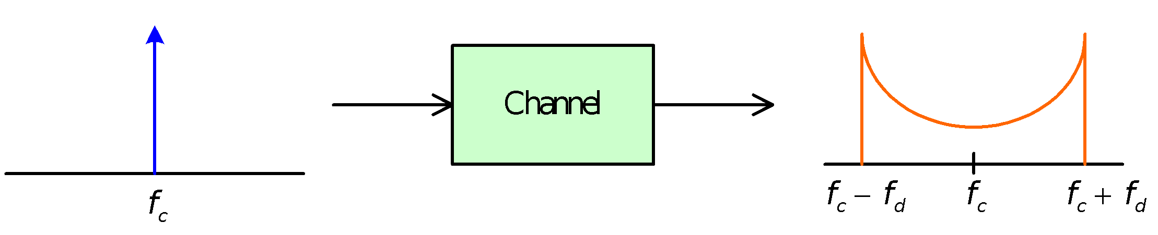
Doppler Spread and Coherent Time
Doppler spread and coherent time are parameters which describe the time varying nature of the channel in a small-scale region.
When a pure sinusoidal tone of is transmitted, the received signal spectrum, called the Doppler spectrum, will have components in the range and , where is the Doppler shift.
is a function of the relative velocity of the mobile, and the angle between the direction of motion of the mobile and direction of arrival of the scattered waves

Slide 22
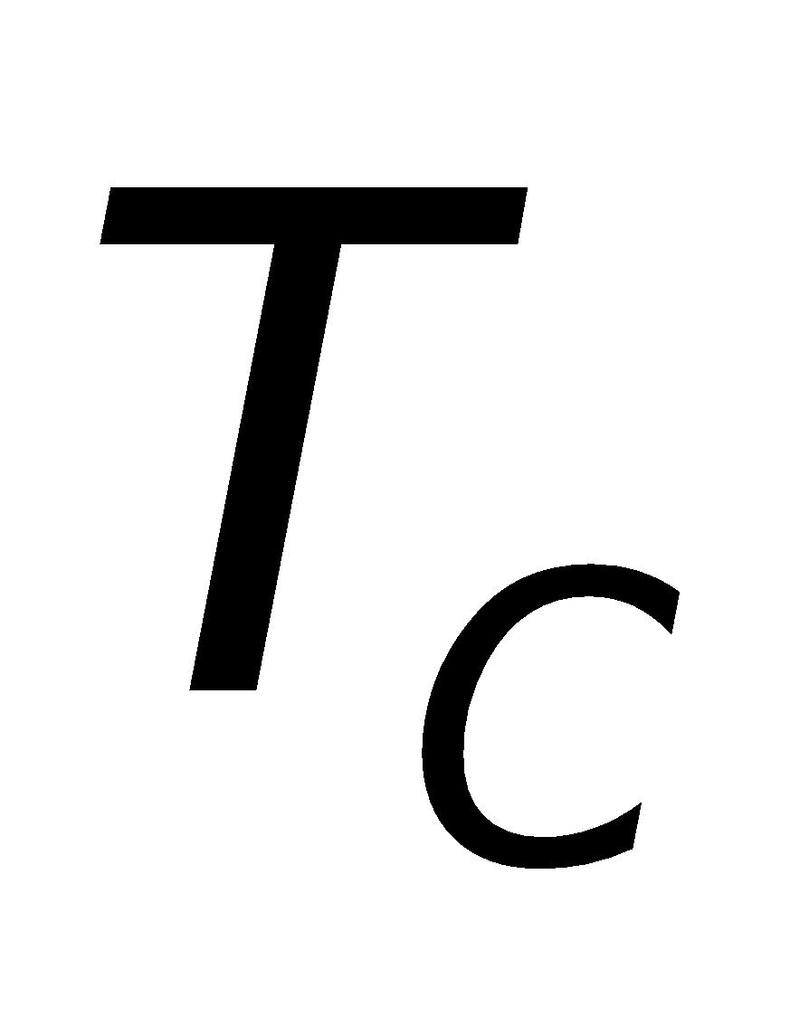
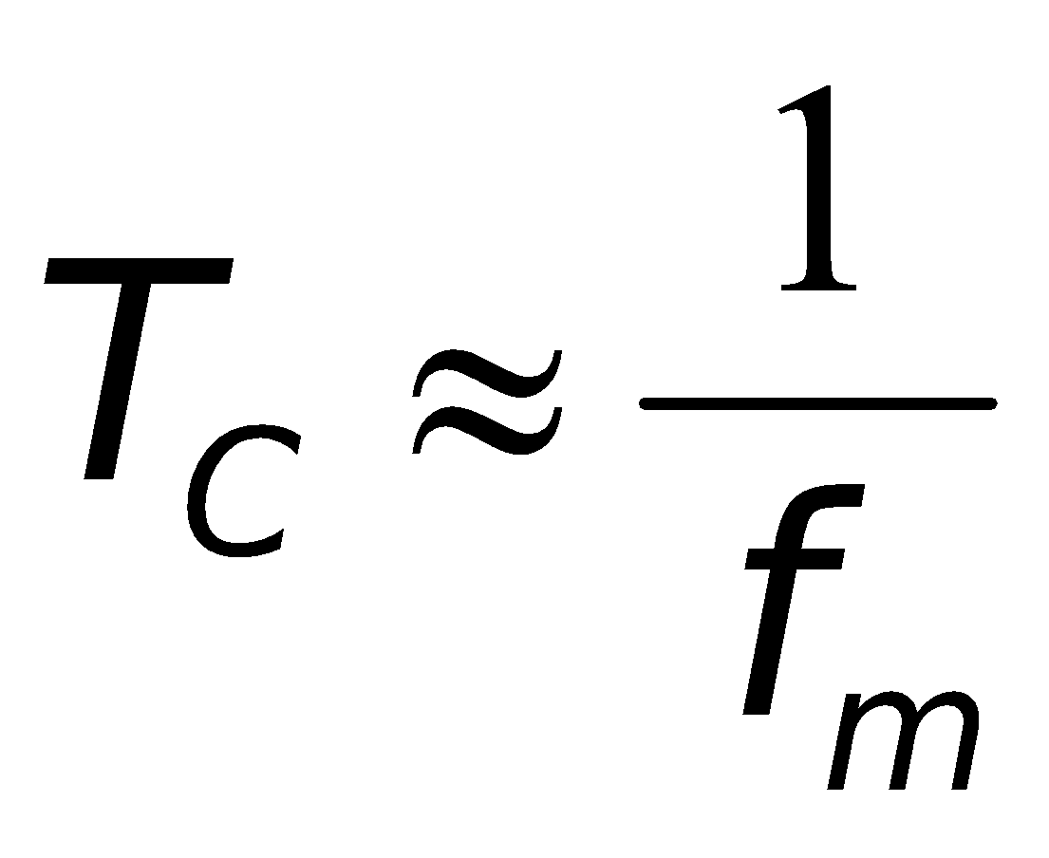
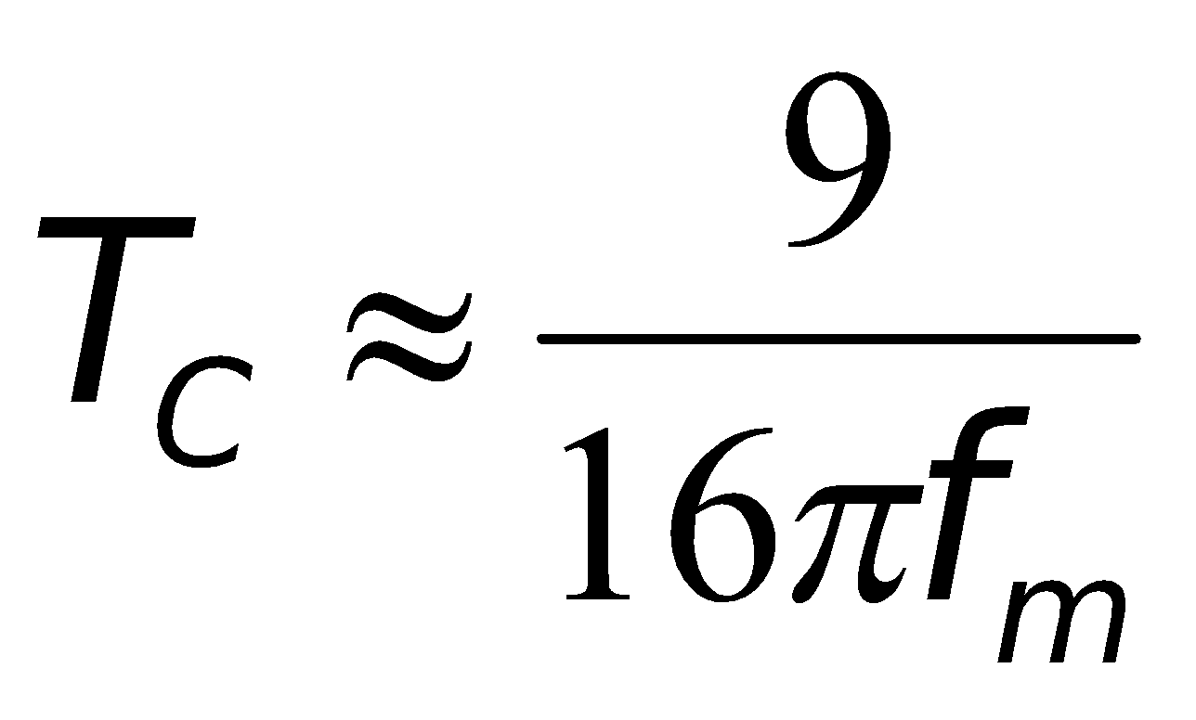
Doppler Spread and Coherent Time
Coherent time is the time domain dual of Doppler spread.
Coherent time is used to characterize the time varying nature of the frequency dispersiveness of the channel in the time domain.
Two signals arriving with a time separation greater than are affected differently by the channel
A statistic measure of the time duration over which the channel impulse response is essentially invariant.
If the coherent time is defined as the time over which the time corrleation function is above 0.5, then

Slide 23
Doppler Spread
Measure of spectral broadening caused by motion
We know how to compute Doppler shift: fd  Doppler spread, BD , is defined as the maximum Doppler shift: fm = v/ λ
if Tx signal bandwidth (Bs ) is large such that Bs >> BD then effects of Doppler spread are NOT important so Doppler spread is only important for low bps (data rate) applications (e.g. paging), slow fading channel

Slide 24
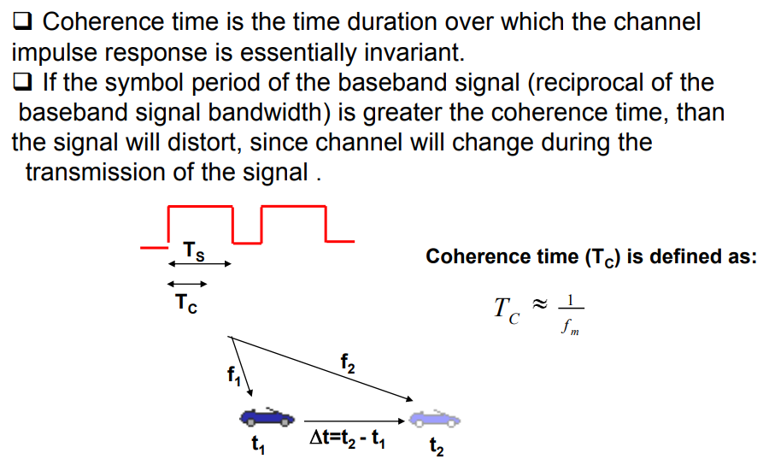
Coherence Time

Slide 25

Coherence Time
Coherence time is also defined as
Coherence time definition implies that two signals arriving with a time separation greater than Tc are affected differently by the channel.

Slide 26
Review Questions
Is Direct RF pulse systems are complex. a) True b) False
False, Direct RF pulse systems have a very attractive system. They lack complexity because of the use of off the shelf equipment. This system can also provide a local average power delay profile.

Slide 27
Review Questions
Direct RF pulse system helps in calculating a. impulse response in frequency domain b. impulse response in phase domain c. power delay of the channel

Slide 28
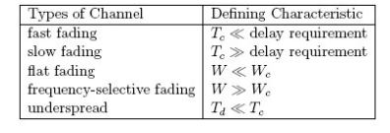
Review Questions
Summarize the different types of wireless channels

Slide 29
Review Questions
What is small scale model?
The propagation models that characterize the rapid fluctuations of the received signal strength over very short travel distances (a few wavelengths) or short time duration.

Slide 30
Review Questions
Factors influencing small scale fading are
1. Speed of surrounding objects
2. Multipath propagation
3. Speed of the mobile
4. Transmission bandwidth of the signal.

